Slide 1

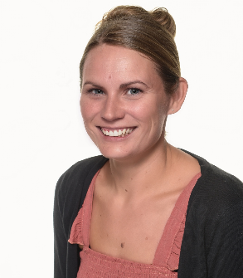
Welcome to year 4: Kingfishers
MR Kilby and Mrs Day

Slide 2
Behaviour Policy
Three Values: Belonging, Believing, Building
Three Rules: Ready, Respectful, Safe

Slide 3
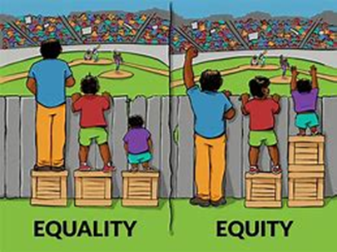
Inclusion
Being fair is not about everyone getting the same (equality) but about everyone getting what they need (equity).

Slide 4

Teaching and learning in our classroom this year
English –
Writing: Become authors who can write for a range of audiences and purposes. We will be writing about Twisted Fairy Tales, villains, far away lands and incredible journeys.
Our book list includes: The True Story of the Three Little Pigs, Inside The Villains, The Land of Roar, The Wild Robot, and The Last Bear.

Slide 5
Teaching and learning in our classroom this year
English –
SPaG: Spelling, Punctuation and Grammar. Daily sessions designed to support children in becoming great writers.
    Weekly spellings to learn (Friday test)
    Daily exercises practising specific mechanics of writing.

Slide 6
Teaching and learning in our classroom this year
English –
Reading: Daily lessons aimed at developing key comprehension skills (inference, retrieval, summarising, prediction, vocabulary).
The key to unlocking everything.
Please read as much as possible at home.
Books in class.

Slide 7
Teaching and learning in our classroom this year
Maths –
Mastering Number
Fluent in 5
Subjects covered in core lesson:
  Column Addition/Subtraction
  Multiplication and Division
  Numbers to 10,000
  Perimeter
  Coordinates
  Fractions
  Symmetry in shape
  Time
Big Focus on Multiplication

Slide 8
Teaching and learning in our classroom this year
Science: - Digestive System, Electricity and Circuits, States of Matter, Sound, Habitats, Liquids.
History: - Anglo Saxons, Changing Lives, Mayans.
Geography: - Rainforests, Food Sources, Rivers.
Art: - Tone and Texture, Light and Dark, Different Fabrics
DT: - Cooking, Mechanical Cars, Electrical Systems
Music: - Music of the world (S. America and Indonesia), Reading the Stave, Singing in parts.
PE: - Football, Orienteering, Tennis, Netball, Gymnastics, Hockey, Rugby, Dance, Cricket, Athletics, Rounders
French: - Portraits, Clothes, Numbers, Food
RE: - Christianity and Hinduism
PSHE:

Slide 9
Teaching and learning
Medium-term and Long-term plans are on the website and cover all subjects.

Slide 10
Homework
Homework will consist of:
English activities: spelling, reading, writing.
Maths: TTRS and an activity to consolidate the week’s learning.
Reading: As much as possible. Can be anything they are interested in (newspaper article, webpage, fiction, non-fiction, lyrics).

Slide 11
Supporting at home
Daily reading
Practise spellings
TTRS
Little and often
Literacy Gold – 15mins, 3 times a week.

Slide 12
WHAT TO BRING TO SCHOOL
Snack – fruit or vegetables
Water bottle – named
Lunch (if required)
Old t-shirt for art activities (to be kept at school)

Slide 13
Days to remember
Monday and Thursday: PE (Please come to school wearing your PE kit).
Wednesday – Homework due.
Friday – Homework handed out.
Friday – Spelling Test.

Slide 14
Communication
Parent Pay – important school communication from the office and used to book school meals, wrap around child care and pay for trips
Email – More official and formal communications
Class Dojo – instant and informal (or emergency) messaging & sharing of photographs
Website- policies, diary dates, curriculum information, useful resources/links
Office Telephone – reporting absence, passing on messages, requesting information/support

Slide 15
Contact
Please keep me in the loop. I am here to help your child progress and want them to enjoy coming to school.
I can’t do this if I don’t know what’s happening.
So please, let me know about anything they’re proud of, events they’re excited about or if they’re feeling sad or nervous about coming to school.

