Slide 1

Welcome to year 4 kingfishers
MISS Copping

Slide 2
WHAT TO BRING TO SCHOOL
Snack for Snack and Story (fruit or vegetables)
Water bottle – named
PE Kit to be worn Monday and Tuesday
Lunch
Book bag with reading record and banded reading book
Old t-shirt for art activities to be kept in school.
(Please do not bring in toys, jewellery or items from home unless this is for
Celebration Assembly, or is specified on your child’s plan or has been arranged with
the class teacher).

Slide 3
Homework
Homework will consist of:
Spelling task or investigation to support the learning objectives of the week.
Ongoing spellings – (from year 2 word list if these are not secure) 3/4 word list
Maths activity to consolidate, use and apply a concept.
Reading, at least 5 times a week and preferably to an adult.
For further opportunities for home learning, a grid of possibilities and any supporting resources can be found on school website under Kingfisher’s page.
Homework to be sent home on Fridays and needs to come back to school
on Wednesday.

Slide 4
Days to remember
Monday – Mrs Shuttleworth teaching pm
Tuesday – Mrs Smith teaching all day
Wednesday – Homework due & Reading Records checked
Monday & Tuesday – PE – come to school in PE kit
(Swimming will be on Tuesdays in term 5)

Slide 5
Teaching and learning
Medium Term Plan is on the website and covers all subjects:
Topic (History, Geography, Art, Design & Technology): Invasion
Maths: Place Value – numbers to 1,000 & Review of column addition & subtraction
English: ‘The Vestments’ and ‘The Owl and the Pussycat’ by Edward Lear, Nonsense Poetry by: Agard, Causley, Milligan, Belloc, Prelutsky and Rosen – How well can you understand ‘clever nonsense’; Gut Garden – A Journey into the Wonderful World of your Microbiome’.
Science: The Digestive System
ICT: Staying Safe Online & Evaluating Digital Content, Research into features of ecosystems.
Music: The Vikings
PSHE: Being Me in My World
Growth Mindset: From Failure to Success
PE: Fundamentals & Football
RE Big Question: Is it possible for everyone to be happy?

Slide 6
Multiplication tables check
‘The purpose of the MTC is to determined whether pupils can recall their times tables fluently, which is essential for future success in mathematics. It will help schools to identify pupils who have not yet mastered their times tables, so that additional support can be provided.’ https://www.gov.uk/guidance/multiplication-tables-check-development-process
We will be practicing multiplications and division daily at school using times tables rockstars, timestables.co.uk, BBC supermovers and skip counting
Things to do at home – BBC supermovers, timestables.co.uk, Sumdog.com, hit the button and quick fire questions.
Test will be administered in June 2024 – dates TBC

Slide 7
Supporting at home
Daily reading
Practice spellings
Practice times tables (1-12)
Real life maths problem solving
Telling the time (analogue, digital and 24hr clocks)
Little and often

Slide 8
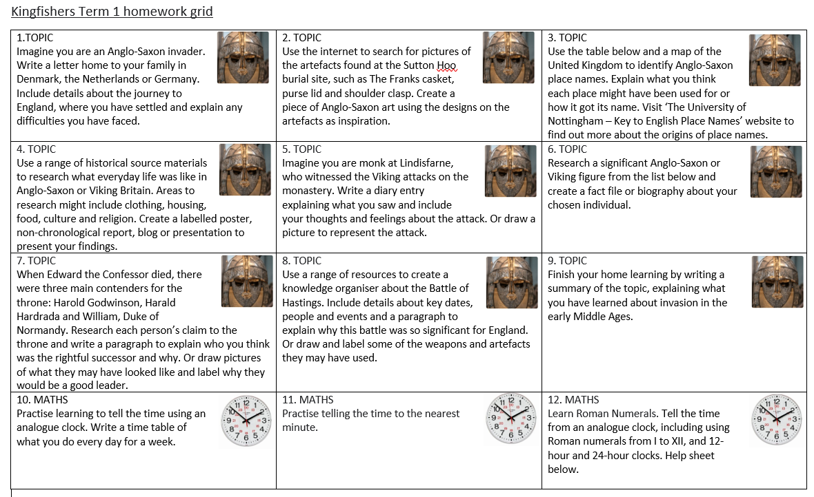
Homework

Slide 9
ON THE WEBSITE
End of year statements for English and Maths
Y3/4 common exception spelling list
These will be posted on the school website - if you would like a hardcopy please let me know.
Any questions? Please send me a message via Dojo or wcop4289@bampton.oxon.sch.uk
Please note that Dojos and emails may not be read during teaching hours. Please contact the school office if you need to report an absence or you require a quicker response than
via Dojo or email.

Slide 10
How would you like to be contacted?
Some parents wish to be contacted via a phone call at the end of a school day;
Some parents would like to be contacted by email;
Some parents prefer to be contacted via Dojo;
Some parents prefer to be contacted in person at pick up time.
To help me know which is best for you and for optimum communication, please complete the questionnaire along with best email address/phone number if this is the option you have chosen.

Slide 11
Thank you for your time.

